Slide 1
Chapter Six
The Literature Review

Slide 2
LEARNING OBJECTIVES:
Identify and source appropriate literature.
Evaluate the quality of literature sourced.
Evaluate the utility for the research project of the literature sourced.
Review literature.
Create a theoretical framework.
Write a literature review.

Slide 3
Introduction
Literature in the context of social science research is research that has already been carried out and published.
Such research is published in journal articles, in books, in theses, in government reports, in the reports of NGO’s, in conference reports, online and in the media.
The literature on a field or area of research
constitutes the body of knowledge in that field
or area of research; it contains the theory in
that field.

Slide 4
The researcher undertakes a review of literature:
to develop their own expertise, their own scholarship, on the topic or phenomenon;
to establish what is known and what is not known in the field;
to highlight gaps in the knowledge base in the area or on the topic, the researcher may decide to use their research project to try to fill in one or more of those gaps;
to be able to create a theoretical framework for
the research project, the theoretical framework
is contained in the literature review. It is the
content of the literature review.

Slide 5
Literature and the Model of the Research Process
In the model of the research process, (see next slide), the literature review is the fourth stage in the research process. In fact, the process of reviewing the literature begins as soon as the researcher has decided to undertake a research project.
As soon as the researcher decides on an area of research, or on a particular topic within an area of research, the researcher begins to read literature around that topic or that broad area.
Reading for the research project begins as soon as the
researcher decides to undertake a research project,
and the reading continues all the way through the
research project.

Slide 6
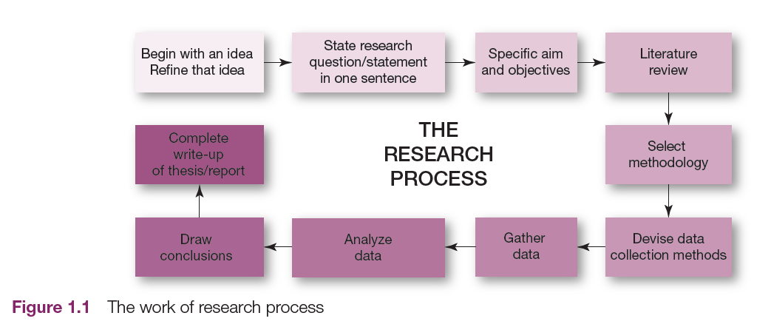
Model of the Research Process

Slide 7
Literature in Research
The word ‘literature’ in social science research, refers to research that has already been carried out and published.
As we have seen above, such literature is published in journal articles, in books, in theses, in government reports, in the reports of NGO’s, in conference reports, online and in the media.
Media reports of research projects tend to be very short. This is because in the media there are usually substantial restrictions in terms of space. Given these restrictions, generally what is reported in the media is a brief synopsis without any
reference to theory, or a theoretical context.

Slide 8
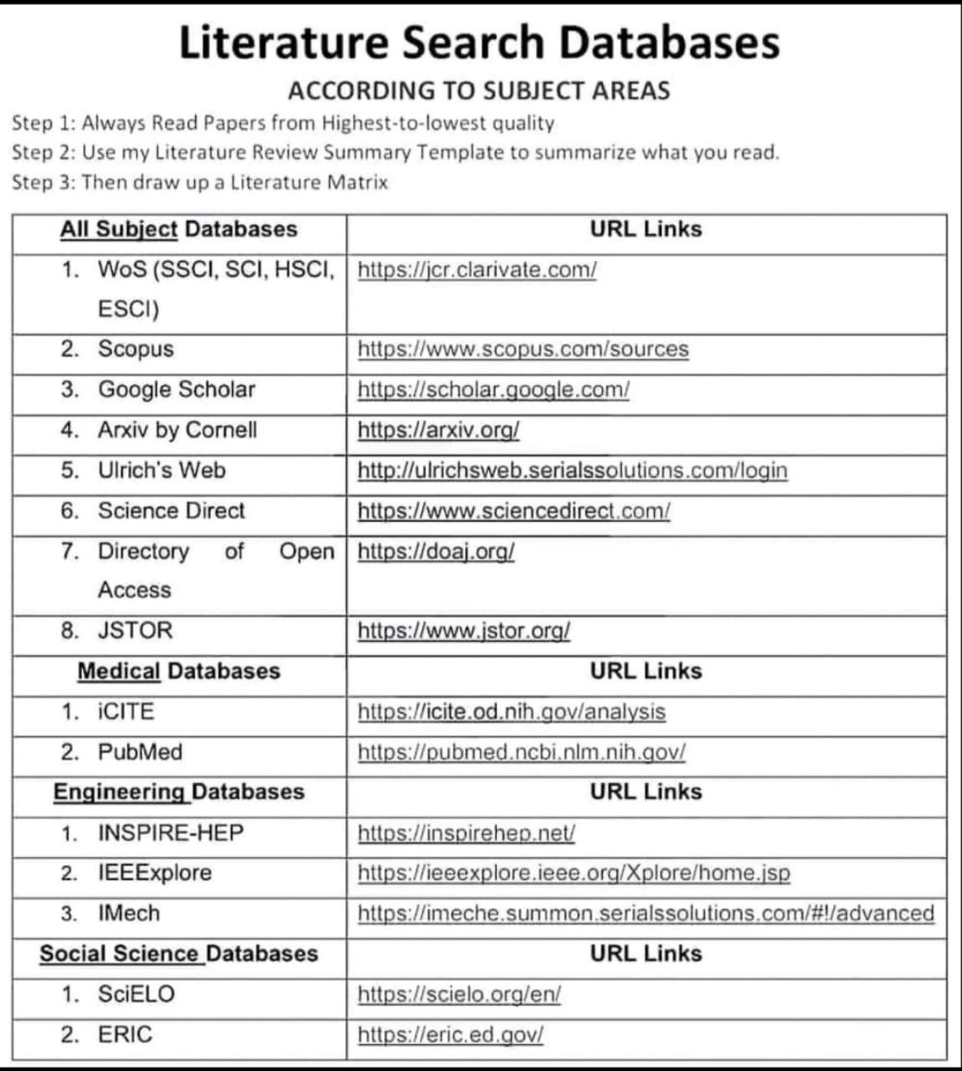

Slide 9
Cont.
The distinction between research which is presented within its theoretical context and research which is not is, in scientific terms, substantial.
Research is about the creation of knowledge. Research projects are designed to make a contribution to some body of knowledge.
As research is designed to contribute to knowledge, the rules, processes and procedures of research are rigorous. For a research project to be established as valid research, it must meet rigorous scientific standards. When a research project does meet these standards, it is accepted as a valid contribution to knowledge. Research which has been established as valid research is research that has been subjected to
peer-review.
Such research is published primarily in journal articles and in
books. While it can be useful and interesting to source
material from other sources, such as the media, it is primarily
these peer-reviewed sources that are used in compiling a
literature review for a research project.

Slide 10
The Conceptual Framework as a Guide to the Review of the Literature
When the researcher commences the search for literature, s/he uses the key concepts in the conceptual framework.
These key concepts are used to provide key words for key word searches
in databases and online.

Slide 11
Cont.
The key concepts, key words and key ideas provide focus and direction for the theoretical framework.
For example, if the word “training” appears in the conceptual framework for the project, the word “training” will be a major feature of the theoretical framework.
If the word “development” appears in the conceptual framework, it will be a major feature of the theoretical framework.
If the word “marketing” or the concept “brand recognition” appear or feature in the
conceptual framework, they will be major
elements in the theoretical framework.

Slide 12
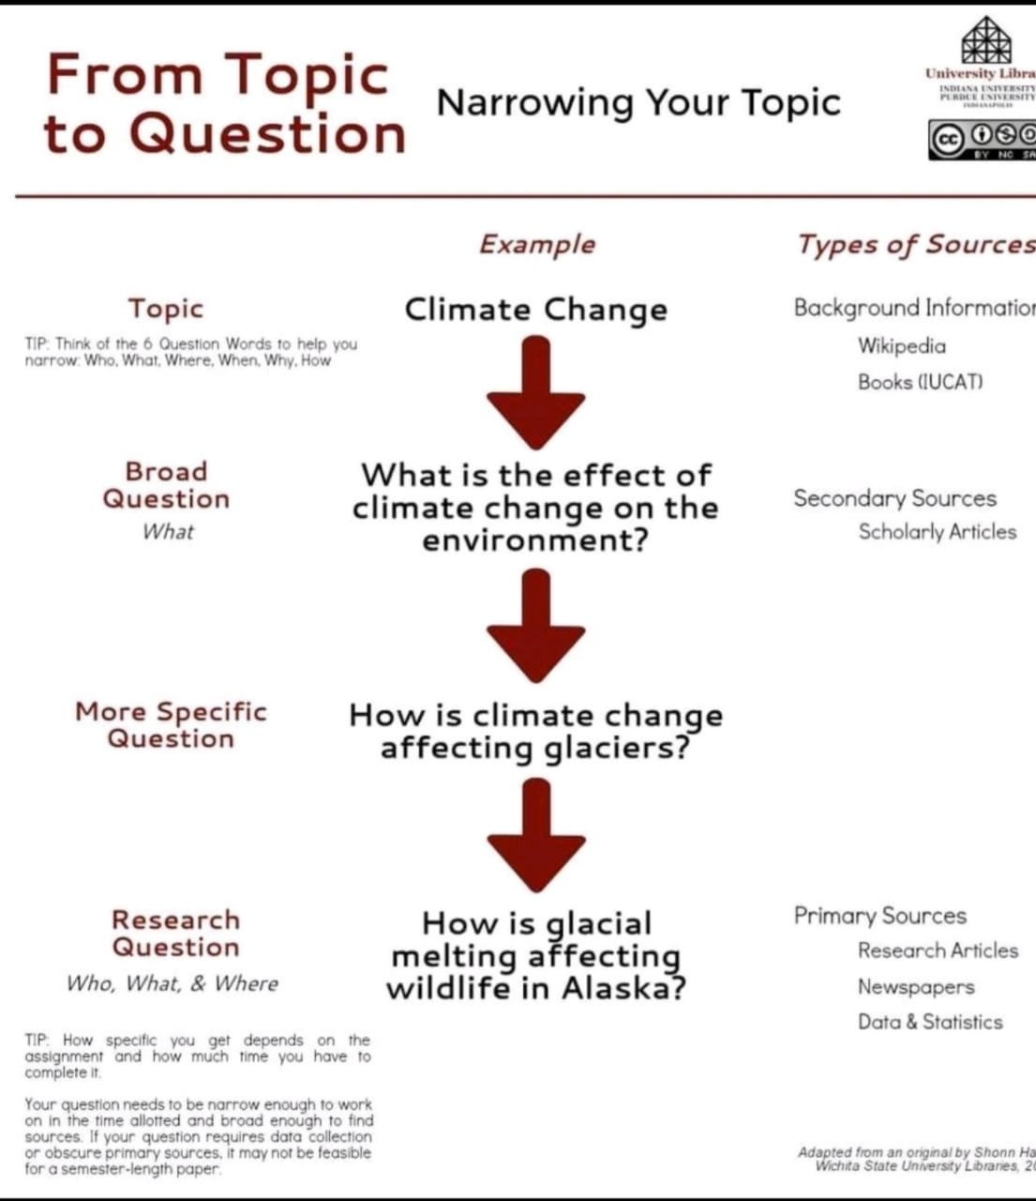

Slide 13
Search Strategy
In order to generate useful and thorough key word searches, the researcher develops a search strategy.
A key objective of the search is that the researcher identifies, sources and develops an understanding of all of the literature relevant to their study.

Slide 14
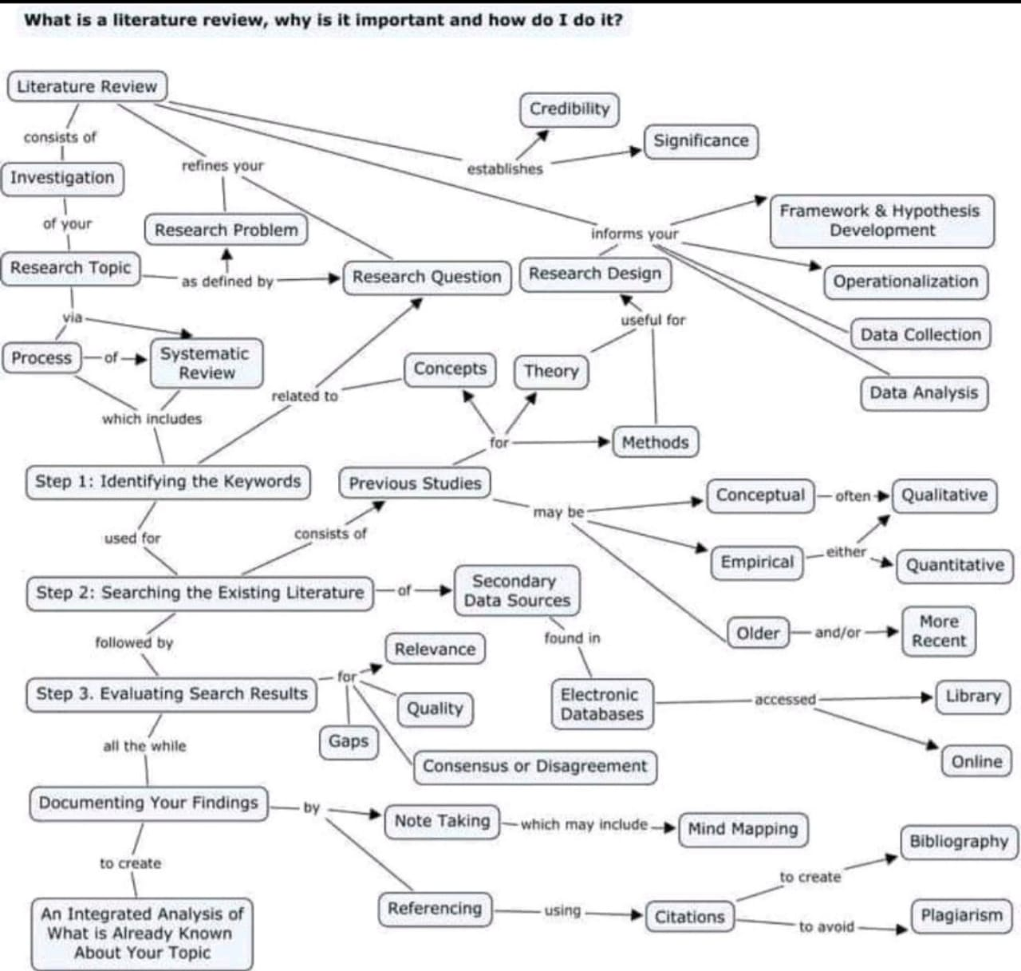

Slide 15
Writing the Literature Review
The first thing to do in terms of writing the literature review is to develop a plan for its structure.
The structure of the literature review is comprised of a good introduction and a good summary; the use of sub-sections with good sub-headings; the use of proper paragraphs and proper sentences; the elimination of
spelling, syntax, grammatical and
punctuation errors.

Slide 16
Structure of the Literature Review
To begin with there is the introduction, this is an introduction to the chapter, nothing else, nothing more
The introduction is followed by a number of sub-sections. There might be two, three, four or five sub-sections.
The chapter ends with a summary.
The summary is a summary of the
chapter, nothing else, nothing
more.

Slide 17
Reading Literature: Some Key Points
In reading literature the researcher engages in an evaluation of the literature.
The literature review is undertaken to provide a theoretical framework for the research project.
The researcher is trying to establish the value of the literature in relation to their own research.
Where was the literature sourced? Is this a good source?
Check the date of publication. Is the literature from seminal sources? Is the literature up-to-date?
Who authored the literature? Do they have other publications?
What are their qualifications?
Take a critical perspective. Use the model of the research
process to examine each aspect of the published work.

Slide 18
Questions for the Introduction to the Research
Critically examine the research question/statement, the research hypothesis.
Does it seem useful and appropriate?
Are the aim and objectives of the research clearly outlined?
Do they seem reasonable and
appropriate?
Do the aim and objectives “fit” with the
research statement/question?

Slide 19
Questions for the Literature Review
Critically examine the literature review, the theoretical framework.
Is it comprehensive?
Does it include seminal authors?
Is it up-to-date?
Does it adequately support the research
project as it is detailed in the research statement/question,
in the hypothesis?

Slide 20
Questions for the Research Methodology
Examine the methodology? Is it appropriate? Has enough detail been given on the methodology to allow for a care critique of the research?
Is the population of the research detailed?
Was a sample used? If so, is the sampling method detailed?
Are the data collection methods outlined?
How well did the data collection methods serve the research?
Do the data collection methods “fit” with the aim of the
research?
Is there a copy of the data collection method(s) in
appendices? (e.g. questionnaire / interview schedule)

Slide 21
Questions for Data Analysis
How were the data analysed?
Was the means of analysis adequate and appropriate?

Slide 22
Questions for the Findings of the Research
Are the findings from the data clearly drawn from the data? Is it clear that the findings did emerge from the data?
Are the findings reasonable, useful, interesting and insightful?
Are the findings theorised? Did the author(s) knit the findings from the research back into
the body of knowledge? Did the
author(s) connect the findings with the
theory laid out in the literature review,
in the theoretical framework?

Slide 23
Questions for the Conclusions Drawn from the Research
Are there conclusions? Are they reasonable and meaningful?
Do the conclusions emerge clearly from the findings?
Do they evidence a deep level of reflection on the part of the researcher?
Are they useful, interesting and
insightful?

Slide 24
Questions for the Recommendations Made at the End of the Study
Are there recommendations?
Are the recommendations clear and simple?
Do the recommendations make sense?
Are the recommendations achievable, are they do-able?
Are there recommendations for further research?

Slide 25
Questions for an Overall Critical Appraisal of the Study
Overall, is the report of the research well written?
Is the research well-presented?
Has the research been carried out to a high standard?
Does the research make a contribution to knowledge?
Is it a valid contribution to knowledge?
Is it a valuable contribution to knowledge?

Slide 26
Referencing the Work
Referencing is critically important.
Much of the work of the literature review is in referencing all of the literature drawn on in writing the review.
It is essential the literature review be fully and properly referenced.
Reference as much as possible in the literature review.
Include all of the references.
Remember to lead with your own voice in writing the
literature review. The literature review that you write is
your take on the literature that you have read, as it
relates to your research project.

Slide 27
Common forms of Plagiarism
“The Ghost Writer”
“The Potluck Paper”
“The Labour of Laziness”
“The Self Stealer”
Sources cited but still plagiarized:
The Forgotten footnote, the misinformer, the too perfect paraphrase etc…

Slide 28
Common problems
Students review irrelevant literature.
Students present unnecessary detail in their review (the case study at the end of this chapter presents an example of a poorly written literature review and an example of a better literature review).
Students fail, in writing their literature review, to present and then develop a main argument in the review.

Slide 29
